Slide 1
UPDATES to Mechanic 2 CA Wireframe
5/4/15

Slide 2
Mechanic 2 Updates
Invest (“Give”)

Slide 3


Letters
Word Chunks
Words
fill
felt
hall
spin
trap
damp
honk
Notes:
Word Selection & Use (for Invest/Use)
Note simplified categories: “Letters” , “Word Chunks” and “Words”.
If player chooses “Words” they are automatically places in Invest/Use mode.
The game design will provide word choices. (We may also want players in G3-5 skill span to be able to use filters—but we need more time to affirm that and figure out how it would work.)
Note Parker’s thoughts about the presentation choices—no “old school” info band at bottom of screen. Let’s talk about how words are presented—we want to be sure that the words are clear and legible for our youngest players.

Slide 4
Say
Give
Letters
Word Chunks
Filter 1
Words
fill
felt
hall
spin
trap
damp
honk
Notes:
Word Selection & Use (for Invest/Use), cont.
Players choose a target for the word. Players can select a target and then a word to use, or a word to use and then a target in either order.
When both word and target are selected, a pop up “radial” menu of options appears arrayed above or around the target.
Options will be displayed as icons with or without the words they represent (e.g. Give, Say). Radial menu appears once player chooses a target.

Slide 5
Say
Give
Letters
Word Chunks
Words
fill
felt
hall
spin
trap
damp
honk
Notes:
Word Selection & Use (for Invest/Use), cont.
Player selects mode in which they want to use the word. In this case “give” icon/word. Which means that the Minis will eat the word and break it into parts (“Invest”).

Slide 6
fill
Letters
Word Chunks
Words
felt
hall
spin
trap
damp
honk
Notes:
Word Selection & Use (for Invest/Use), cont.
Player selects mode in which they want to use the word. IN this case “give” icon/word. Which means that the Minis will eat the word and break it into parts (“Invest”).

Slide 7
f
ill
Letters
Word Chunks
Words
felt
hall
spin
trap
damp
honk
Notes:
Word Selection & Use (for Invest/Use), cont.
Minis generate various word components (which are automatically stored in Book or strewn about for player to collect).
Word components are choked/coughed up or otherwise regurgitated and fly from Minis’ mouths with animation (or programmed arcs), sounds and FX.
Word components float in the air or fall to the ground and wait (with sparkling FX) for players to collect (sound effect).

Slide 8
Mechanic 2 Updates
Use

Slide 9
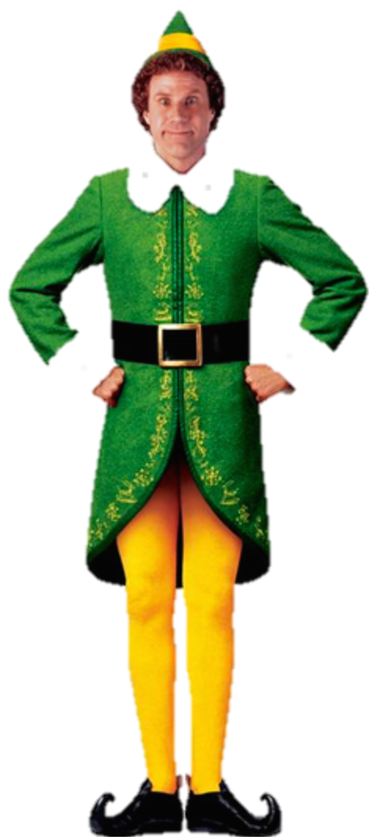
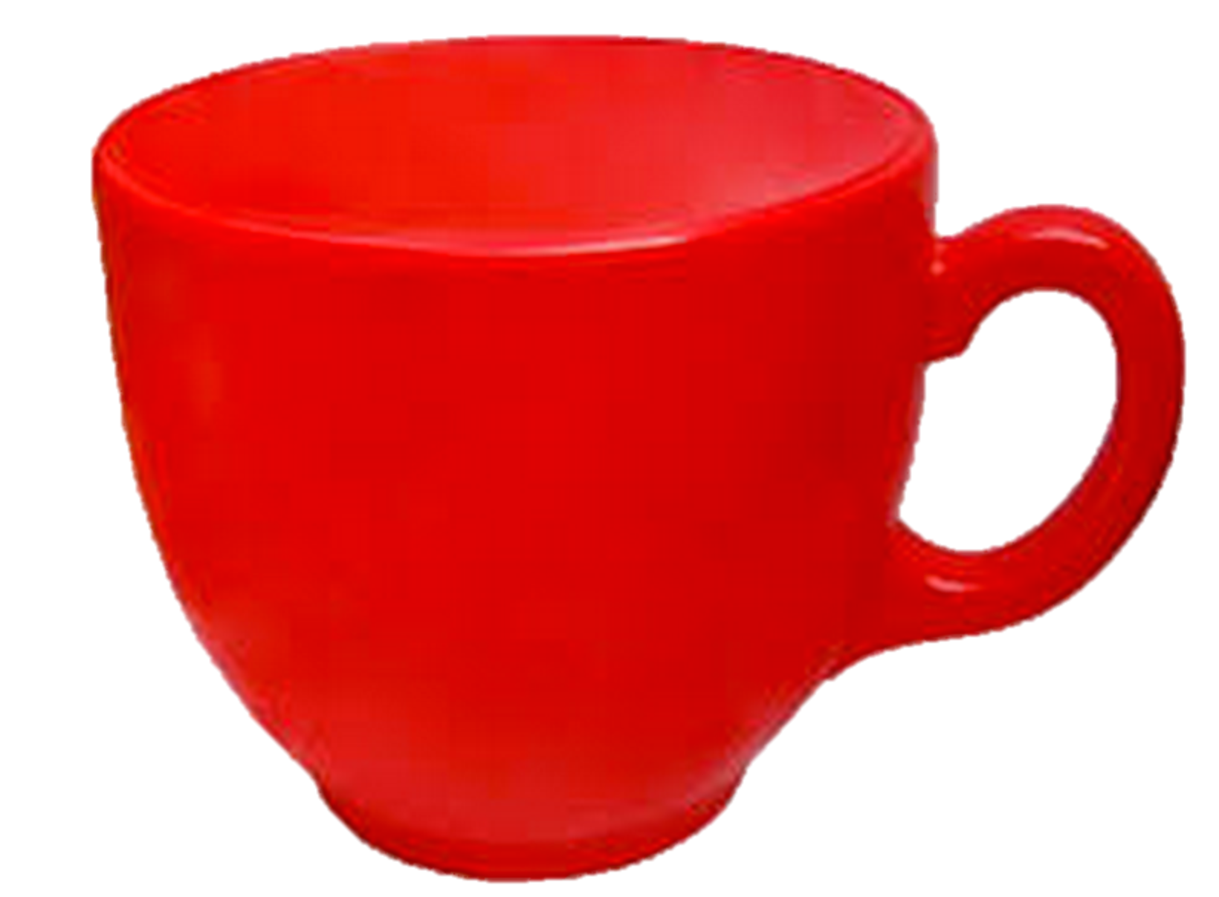
Use
Help!
I need to ____ up this cup.
Letters
Word Chunks
Words
fill
felt
hall
spin
trap
damp
honk
Notes:
Word Selection & Use (for Invest/Use), cont.
When player wants to complete sentences in quests or fulfill NPC requests, player chooses word and target.
Menu option appears behind target. (Let’s discuss—does this make sense?)

Slide 10
Help!
I need to fill up this cup.
Letters
Word Chunks
Words
felt
hall
spin
trap
damp
honk
Notes:
Word Selection & Use (for Invest/Use), cont.
Word flies in to sentence.

Slide 11
Mechanic 2 Updates
Use (Type “Say”)

Slide 12
Say
Give
Letters
Word Chunks
Filter 1
Words
fill
felt
hall
spin
trap
damp
honk
Notes:
Word Selection & Use (for Invest/Use), cont.
Players choose a target for the word. Players can select a target and then a word to use, or a word to use and then a target in either order.
When both word and target are selected, a pop up “radial” menu of options appears arrayed above or around the target.
Options will be displayed as icons with or without the words they represent (e.g. Use, Give, Say, etc.).Radial menu appears once player chooses a target.

Slide 13
Say
Give
Letters
Word Chunks
Words
fill
felt
hall
spin
trap
damp
honk
Notes:
Word Selection & Use (for Invest/Use), cont.
Player selects mode in which they want to use the word. IN this case “say” icon/word. Which means that the Minis will provide a scrambled sentence to unscramble.

Slide 14
fill
Letters
Word Chunks
Words
felt
hall
spin
trap
damp
honk
Notes:
Word Selection & Use (for Invest/Use), cont.
Word is delivered to Mini.

Slide 15

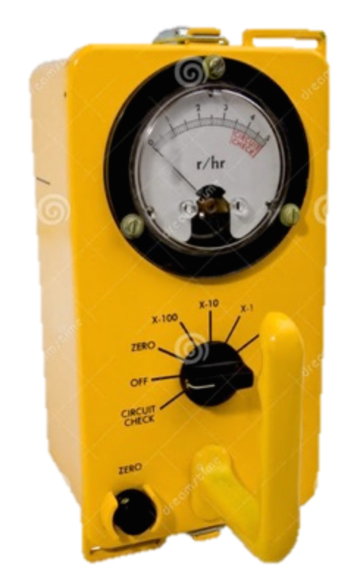
in Fill in this sentence. blank the
?
in
Fill
in
this
sentence.
blank
the
Notes:
Word Selection & Use (for Invest/Use), cont.
Mini generates sentence to unscramble and mode switches to unscrambling sentences, see Mechanic 3.

Slide 16
Mechanic 2 Updates
Craft

Slide 17
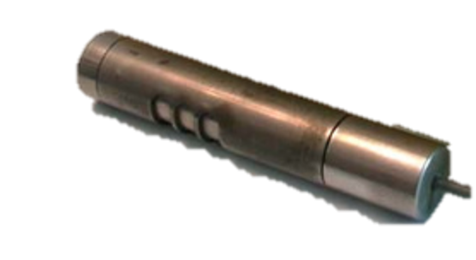
sp
Letters
Word Chunks
Words
sp
bl
tw
tr
lt
sw
sn
Notes:
Word Crafting
When player select “Word Chunks” or “Letters” game enters Craft mode automatically.
Players selects and submit the word components to the tool in Craft mode (possibly with a single click with select and submit as one action).
Player will need to see components they have chosen somehow. Also they may need to be able to choose words as well as components, yet remain in Craft mode—an issue to discuss further.

Slide 18
sp
i
lt
Letters
Word Chunks
Words
sp
bl
tw
tr
lt
sw
sn
Notes:
Word Crafting
When all components are correctly lined up, lever activates.

Slide 19
sp
i
lt
Letters
Word Chunks
Words
sp
bl
tw
tr
fl
sw
sn
Notes:
Word Crafting
Player chooses lever for ‘Word fusion” as in Mechanic 1.

